Slide 2
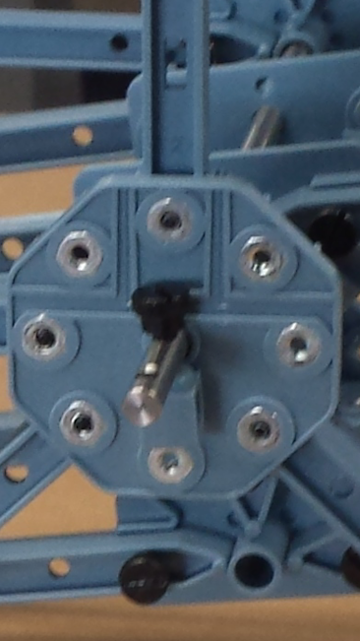
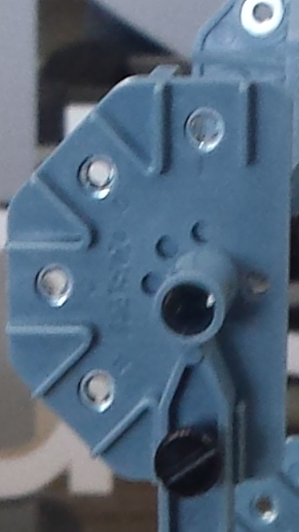
Parts you will need:
30
2
8 – of size 4
10 – of size 5
4- of size 3
24- of size 1

Slide 3
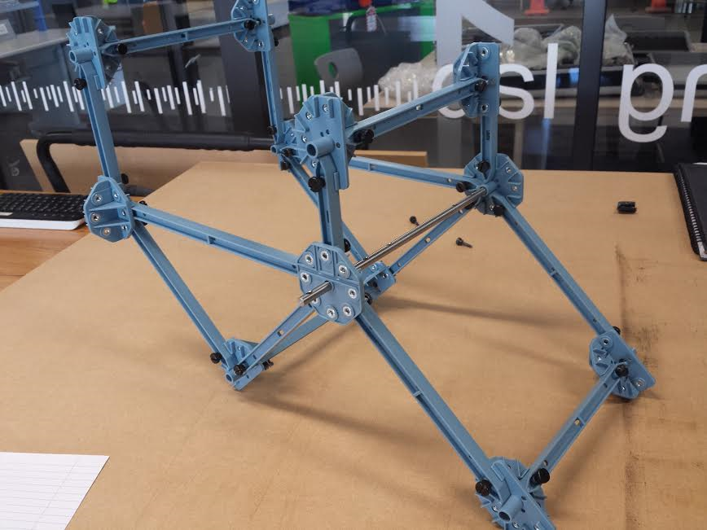
Made a direct copy of this desgin

Slide 4
