Slide 1
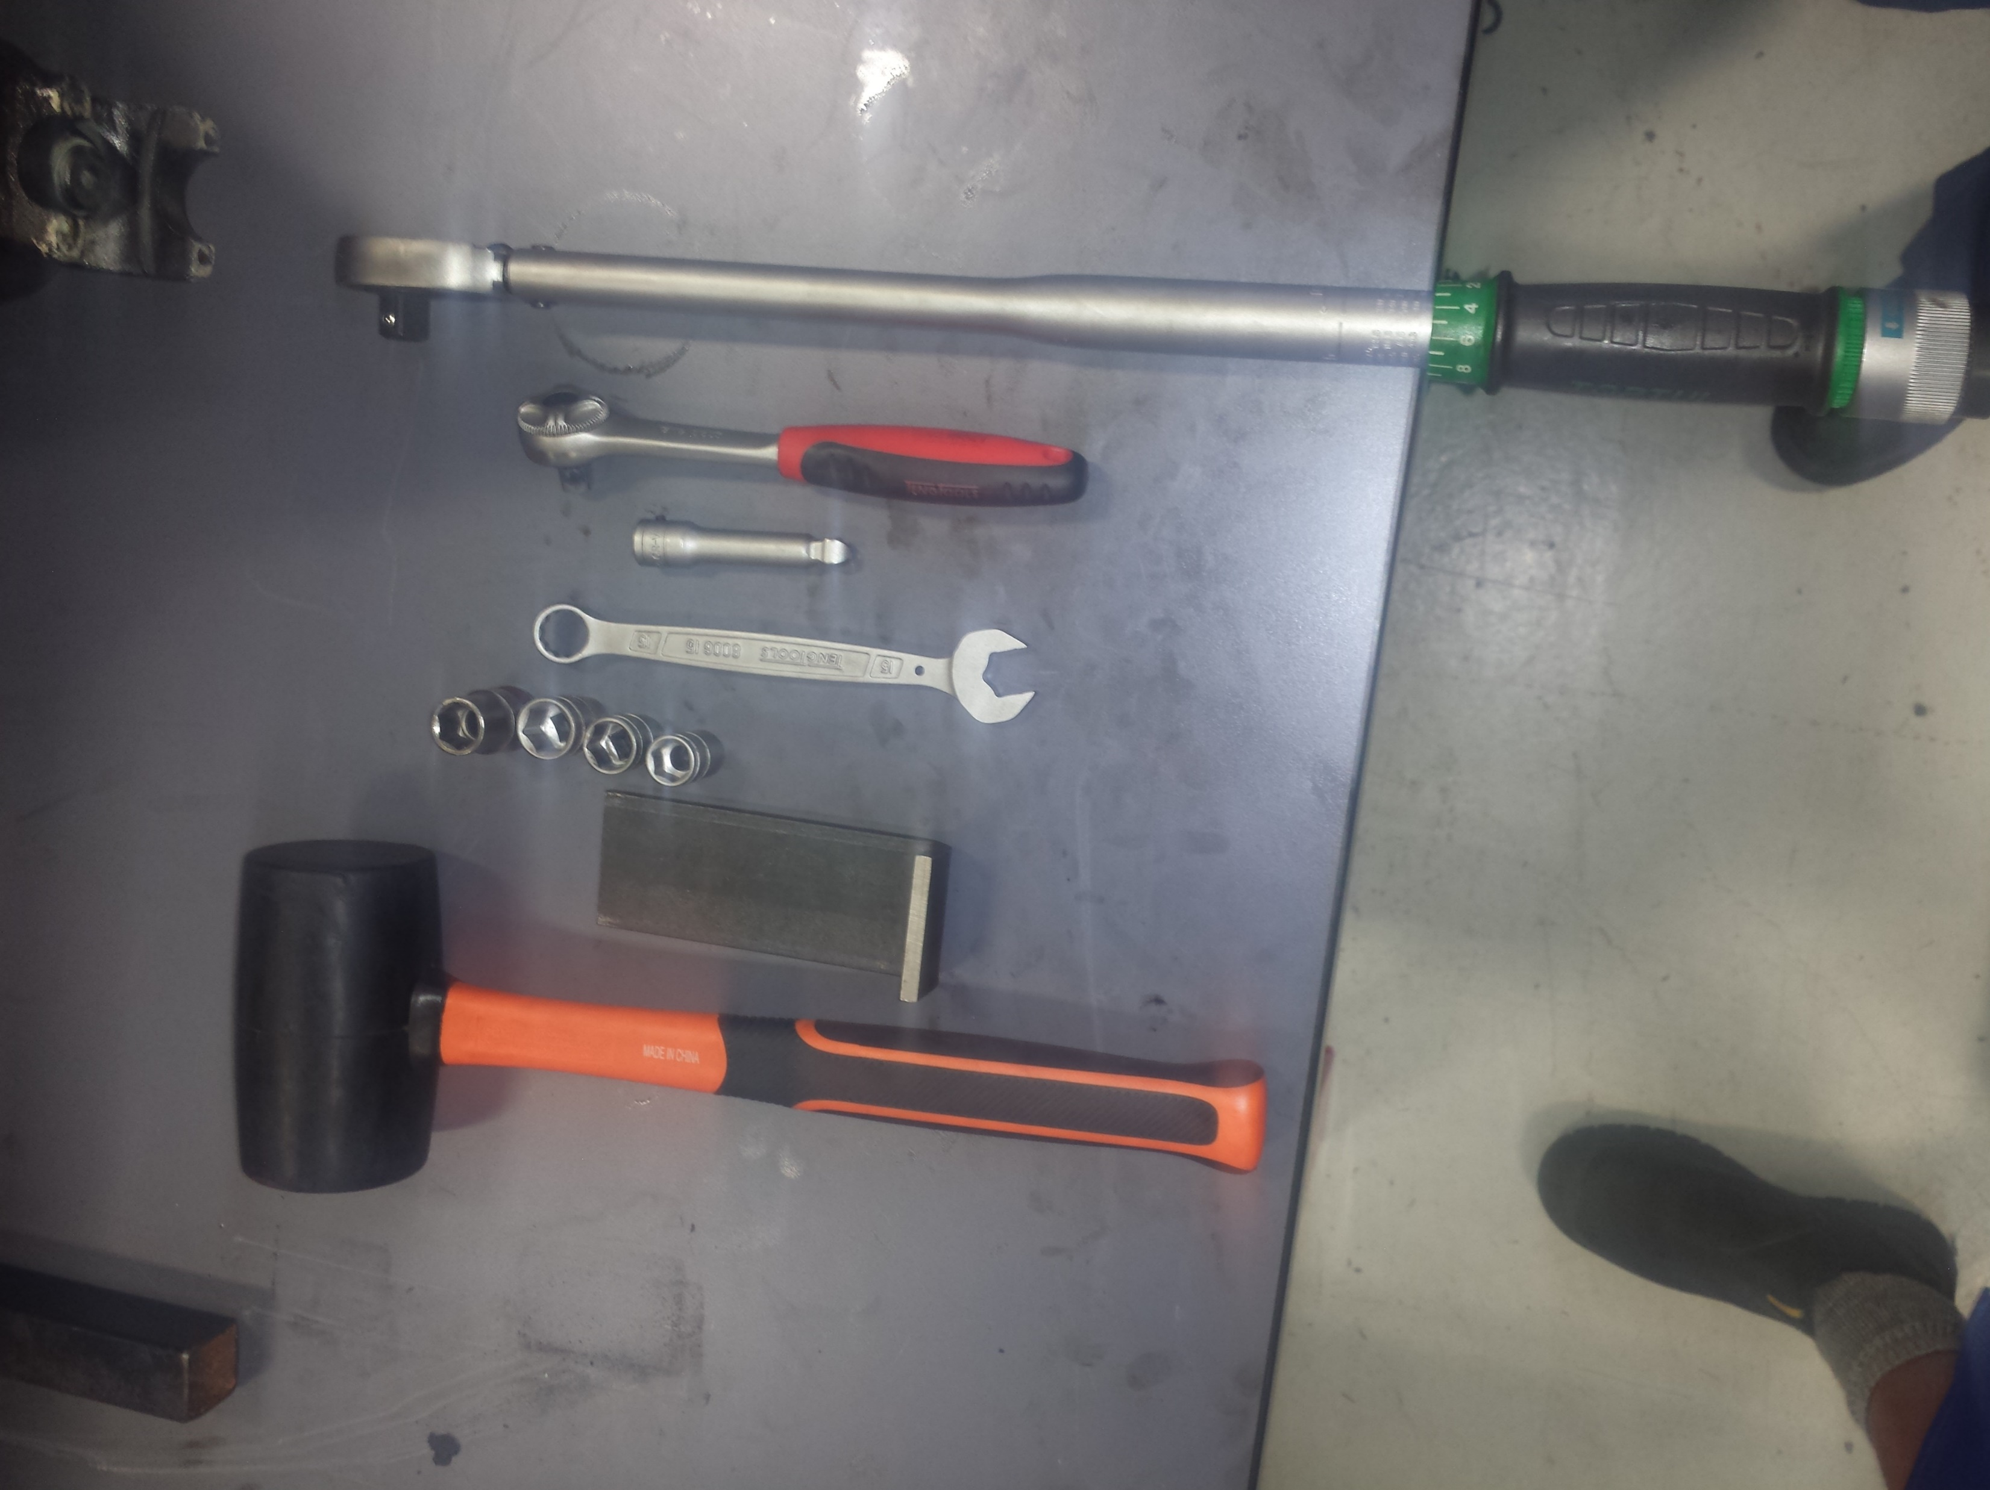
Items you will need:
*13-15-16mm sockets
*Special 15mm socket for the torque wrench
*Ratchet and extender
*Torque wrench
*15mm spanner
*Rubber hammer

Slide 2
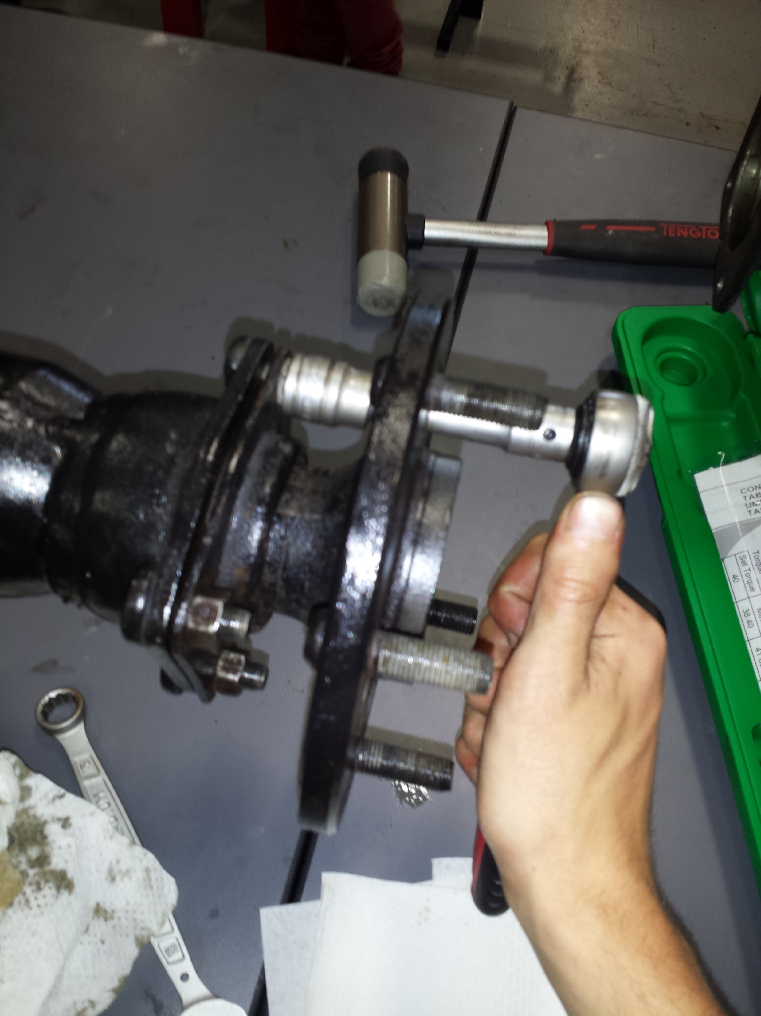
Produced to use the 15mm socket with the adaptor on the 4 bolts to remove the hub from the diff. place somewhere for safe keeping..

Slide 3
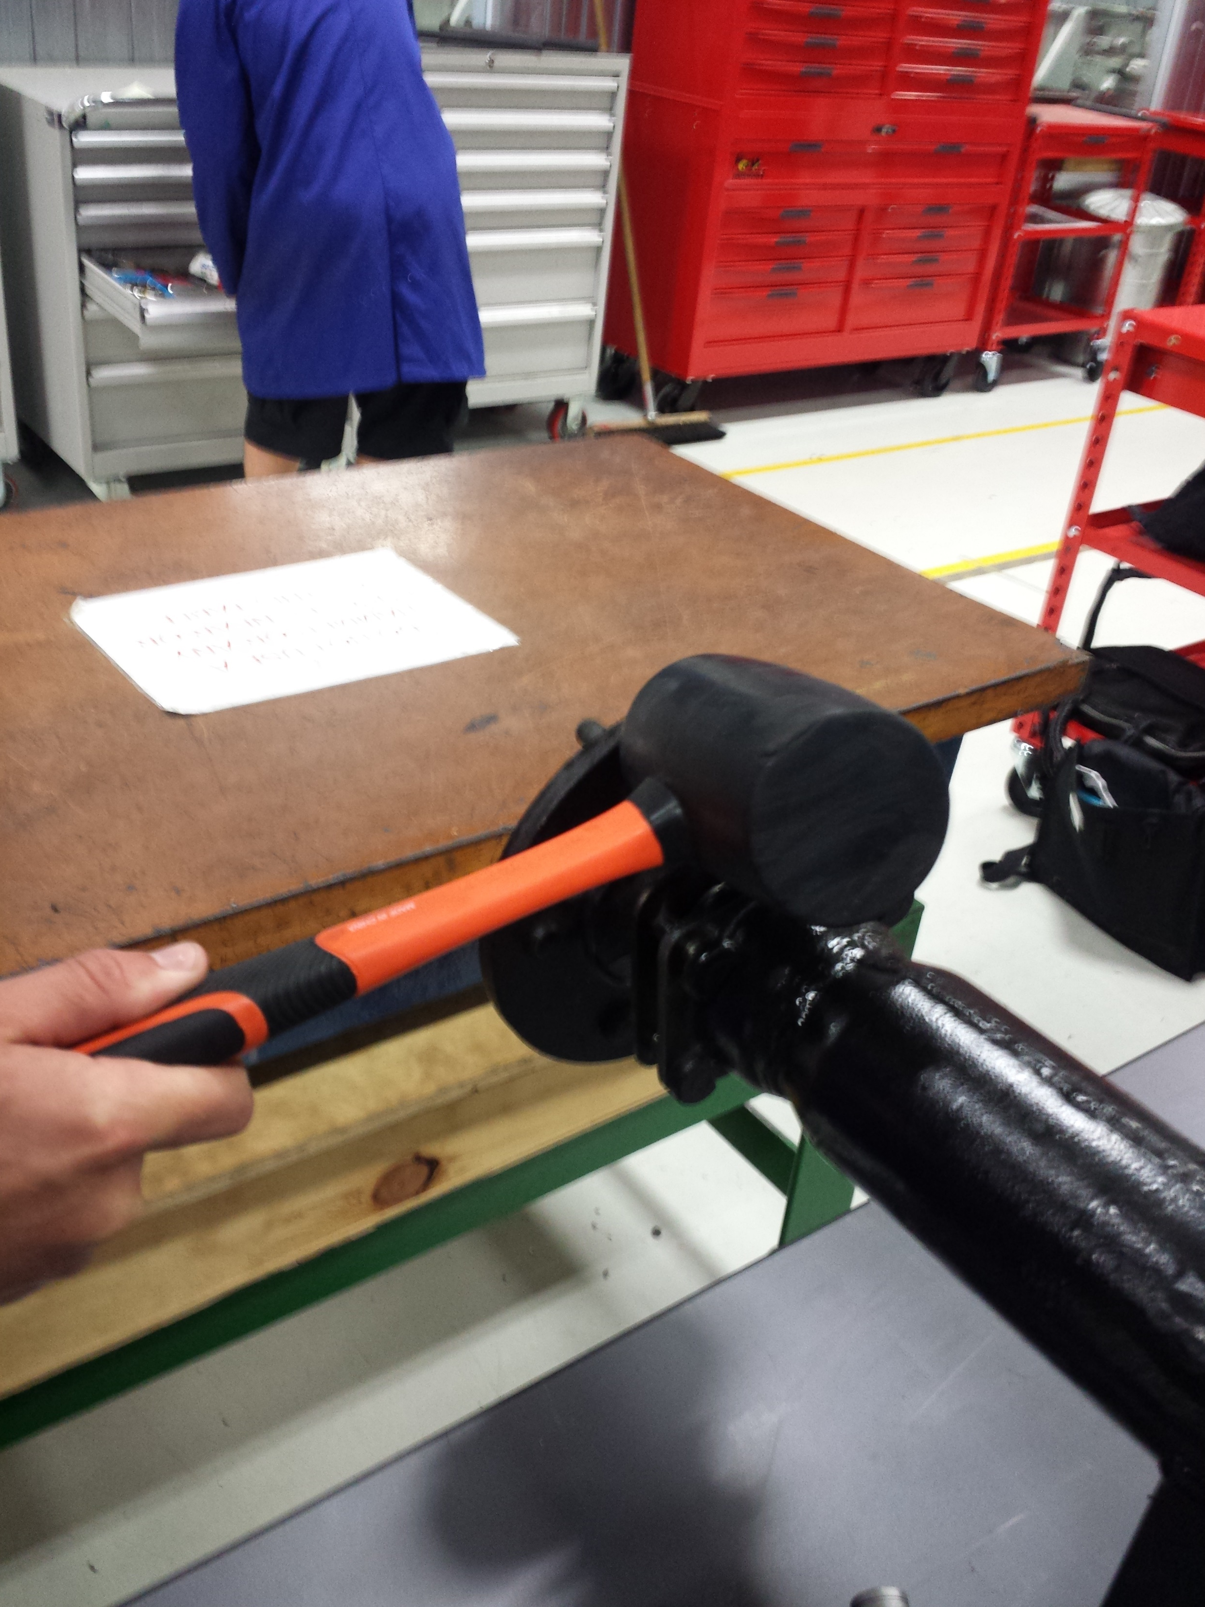
Once all 4 bolts have been removed, proceed to hit the hub with the rubber hammer in the direction the photo demonstrates (some force is needed)

Slide 4
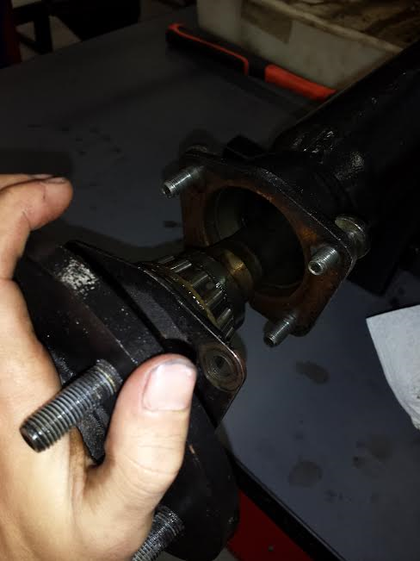
Once the hub has become free, proceed to pull in out and place it somewhere safe with the bolts.
Carry out the same task on the other side.

Slide 5
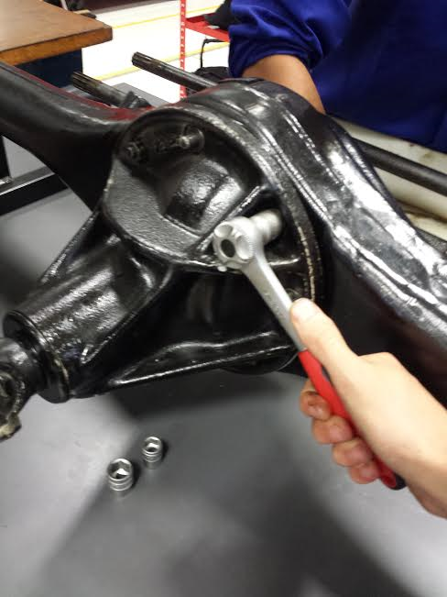
Proceed to removing the diff head, use the 15mm spanner or ratchet to remove 7 nuts and 1 blot that hold the diff head into place. (place nuts and bolt into a pile so they don’t become mixed up with others)

Slide 6
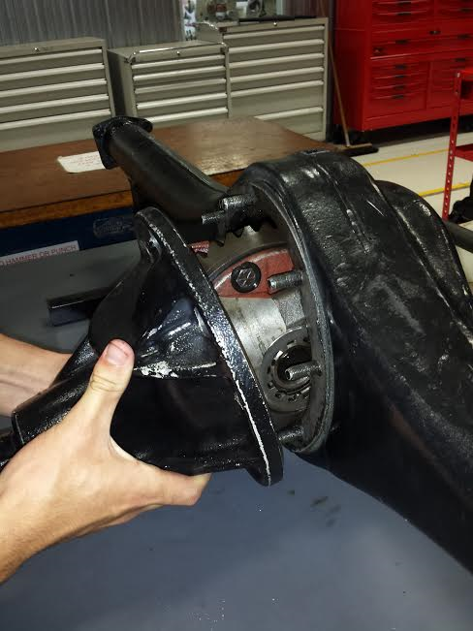
Once all nuts and blot have been removed, proceed to remove the diff head in the direction demonstrated in the photo. Be careful as the diff head is heavy, place in a manor that it cannot roll off the bench when removing the diff internals.

Slide 7
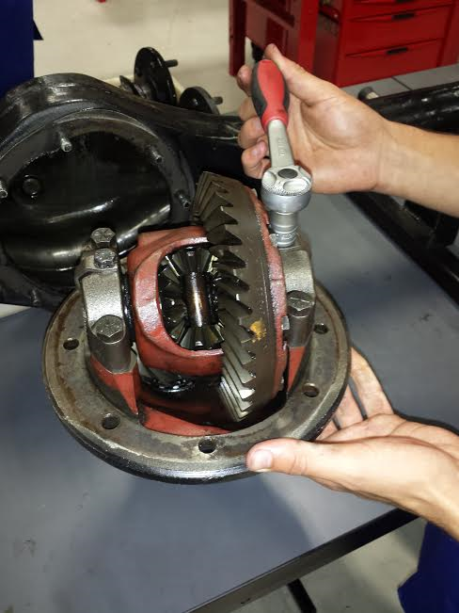
Remove the 2 blots shown in the photo using the 13mm socket, you may need help supporting the diff head as this process can be awkward to carry out alone. Place bolts aside to not get mixed up with the others.

Slide 8
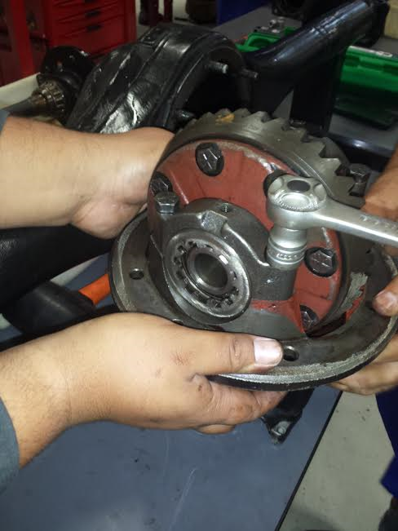
Start by removing the 4 bolts shown in the photo to remove the diff internals from the head. Use the 16mm socket on the bolts shown in the photo, place somewhere not to get mixed up with other bolts. Get another partner in your group to hold the diff head well you're undoing the blots.

Slide 9
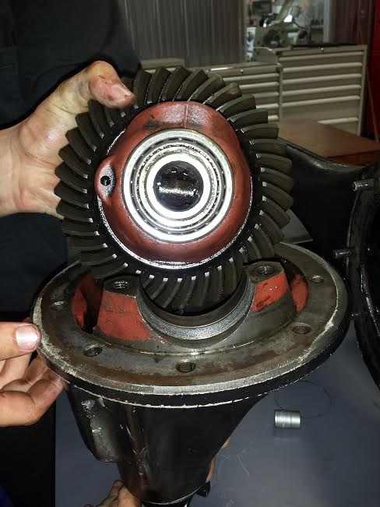
When Removing the diff internals lift up the end covers you just undid and pull the internals straight up, being carful not to lose the bearings on the end. Place the internals somewhere stable on the bench so you're able to remove the next parts.
bearing

Slide 10
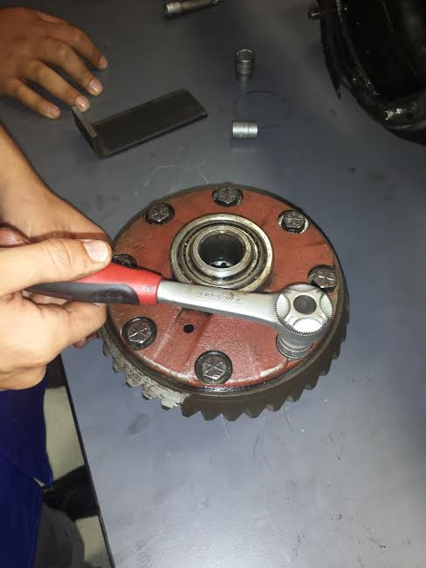
Re-movement of the crown wheel. using the 15mm socket undo all 8 blots holding the crown to the internals, get another member of the group to help hold the internals as you proceed to undo the bolts.

Slide 11
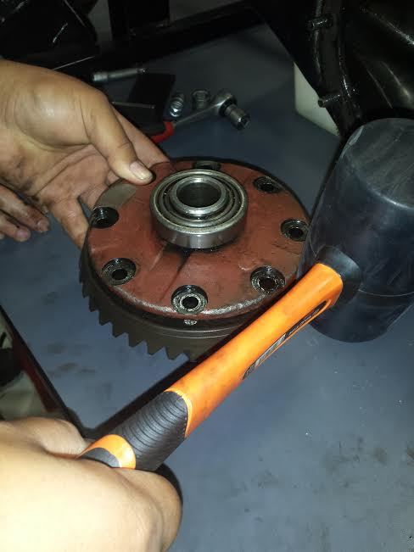
To remove the crown from the internals you will need to use the rubber hammer, aiming to hit the crown, give it 2 hits then move to the next spot on the opposite side. As shown in the photo.

Slide 12
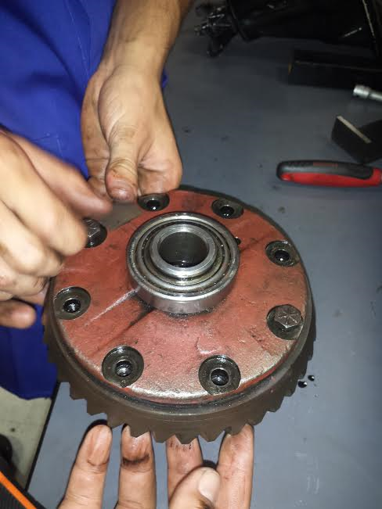
You have now removed the crown and you will start to reassemble the diff, when doing the bolts back up do it in a Kris cross pattern as shown in the photo. Use the 15mm socket then torque to 20nm. Get a group member to help hold the diff internals.

Slide 13
Proceed to place the diff internals back into the diff head making sure that the end bearings are sitting in snug, place the end caps back over the bearing and proceed to do the bolts up hand tight.
Do on both sides.

Slide 14
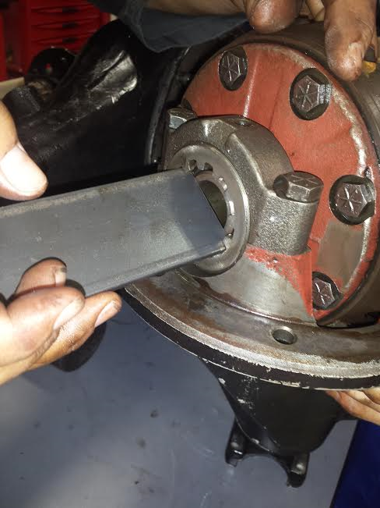
Using the tool provided screw the end piece back into the diff head as shown in photo. Tighten all the way and then untighten about half a turn, proceed to do so on the other side. Then tighten the blots shown in the photo to 20nm to hold everything in place using the 16mm socket.

Slide 15
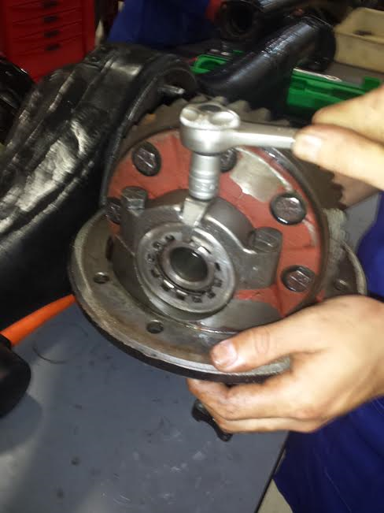
Do the bolt shown in the photo up to 20nm, using the 13mm socket, get a group member to help you hold the diff head. Do so on the other side.

Slide 16
Place the diff head back into the diff, using the 15mm socket do up all the bolts and nut in a Kris cross pattern, as shown in the photo to the left. Torque up to 20nm.

Slide 17
Install the hub back into the diff, push in in the direction as shown, for help getting it back into place turn the driver head that is located on the diff head. Do the 4 nuts up to 20nm using a 15mm socket. Proceed to do so on the other side. Turn the driver head to make sure everything is working correctly.

